Slide 1

Rockbuster Stealth data analysis project
Allie Qualman
May 31st, 2022

Slide 2
Key Questions and Objectives
Which movies contributed the most/least revenue gain?
What was the average rental duration for all videos?
Which countries are Rockbuster customers based in?
Where are customers with a high lifetime value based?
Do sales figures vary between geographic regions?

Slide 3
Which movies contributed the most & least revenue gain?
Most Revenue
Least Revenue
Rank | Movie | Revenue
1 | Telegraph Voyage | 215.75
2 | Zorro Ark | 199.72
3 | Wife Turn | 198.73
4 | Innocent Usual | 191.74
5 | Hustler Party | 190.78
6 | Saturday Lambs | 190.74
7 | Titans Jerk | 186.73
8 | Harry Idaho | 177.73
9 | Torque Bound | 169.76
10 | Dogma Family | 168.72
Rank | Movie | Revenue
1 | Duffel Apocalypse | 5.94
2 | Oklahoma Jumanji | 5.94
3 | Texas Watch | 5.94
4 | Freedom Cleopatra | 5.95
5 | Rebel Airport | 6.93
6 | Young Language | 6.93
7 | Cruelty Unforgiven | 6.94
8 | Treatment Jekyll | 6.94
9 | Lights Deer | 7.93
10 | Japanese Run | 7.94

Slide 4
What Was The Average Rental Duration For All Videos?
 | Range | Average
Rental Duration (Days) | 3-7 Days | 5 Days
Rental Rate ($) | .99 - 4.99 | 2.98
Movie Length (Minutes) | 46 - 185 | 115
Replacement Cost ($) | 9.99 – 29.99 | 19.99

Slide 5
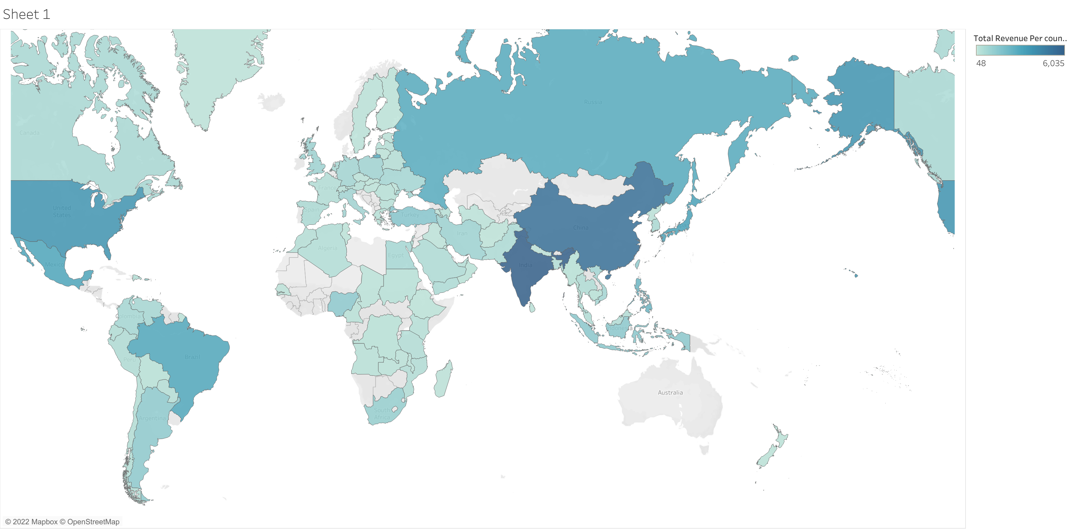
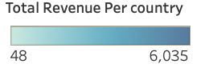
Do Sales Figures Vary Between Geographic Region?
Revenue From Top 5 Countries
Rank | Country | Revenue
1 | India | 6034.78
2 | China | 5251.03
3 | United States | 3685.31
4 | Japan | 3122.51
5 | Mexico | 2984.82
All countries colored are customers of Rockbuster. The darker the blue, the more revenue the country brought in.

Slide 6
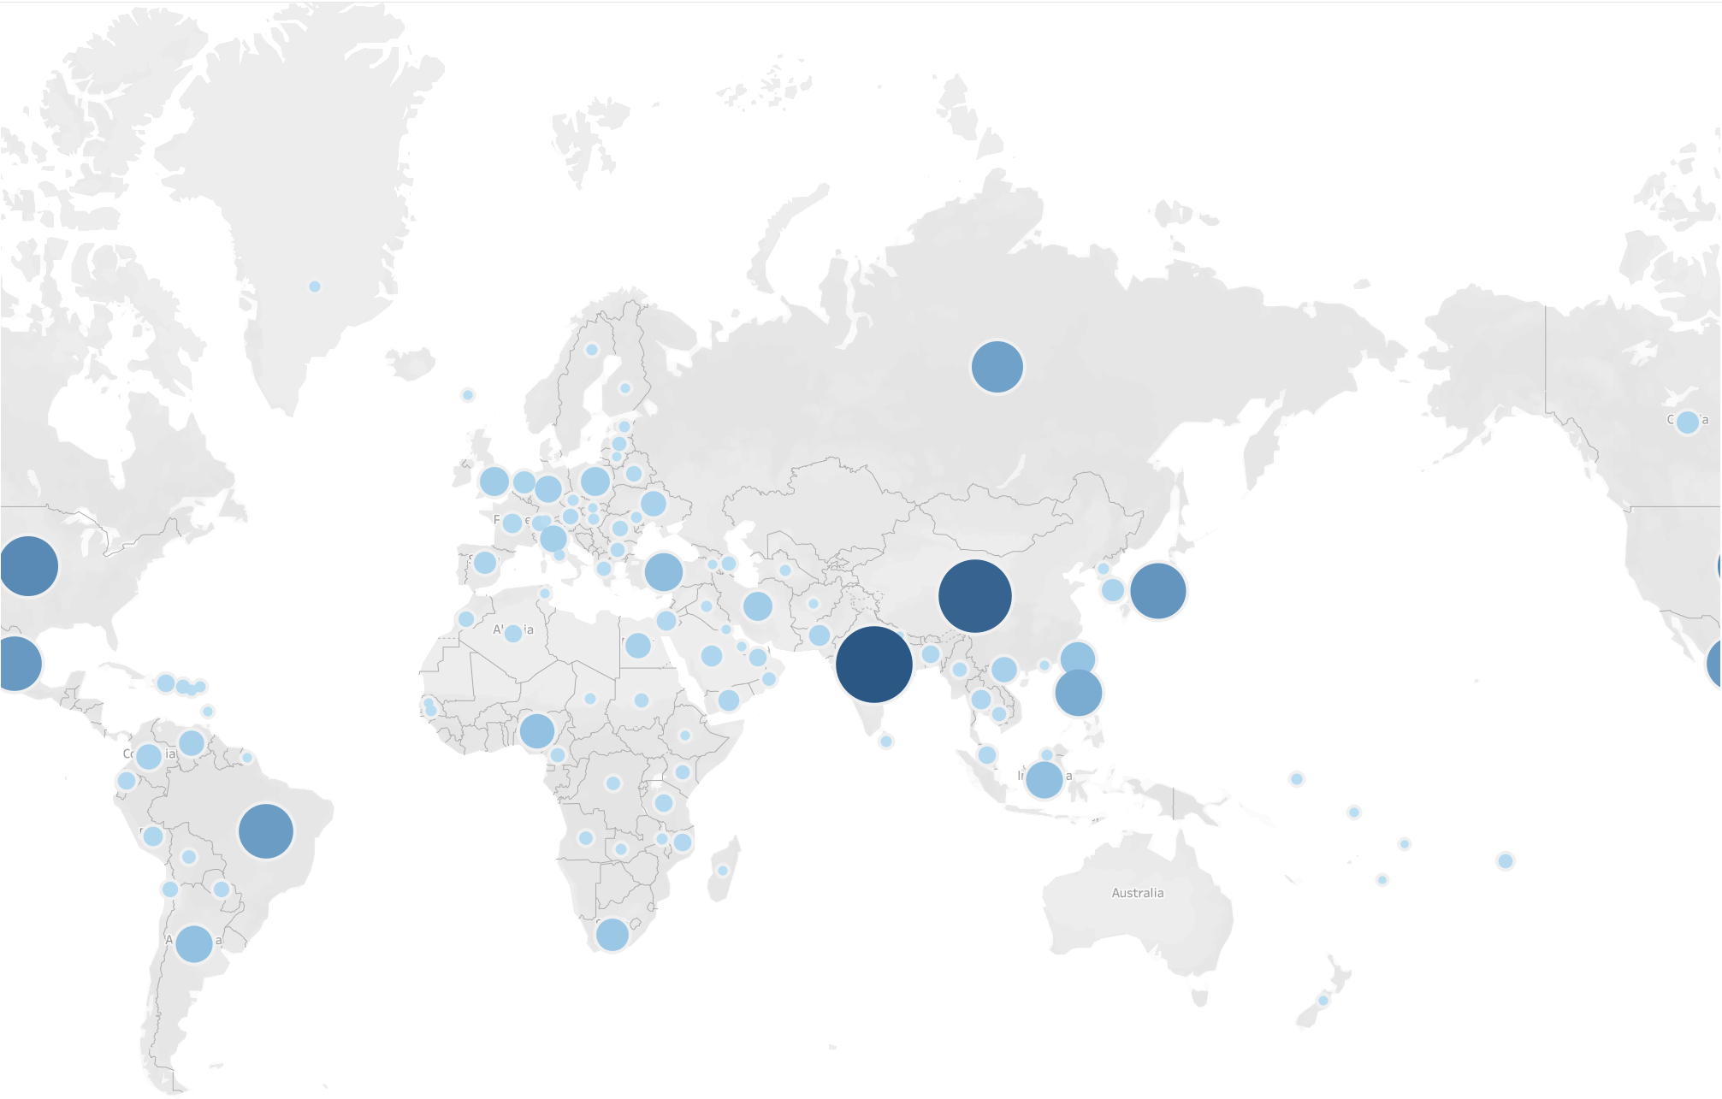
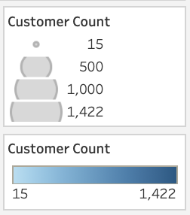
Which Countries are Rockbuster Customers Based In?
Country | Customer Count
India | 1422
China | 1297
United States | 869
Japan | 749
Mexico | 718
Brazil | 681
Russian Federation | 638
Philippines | 530
Turkey | 351
Indonesia | 331

Slide 7
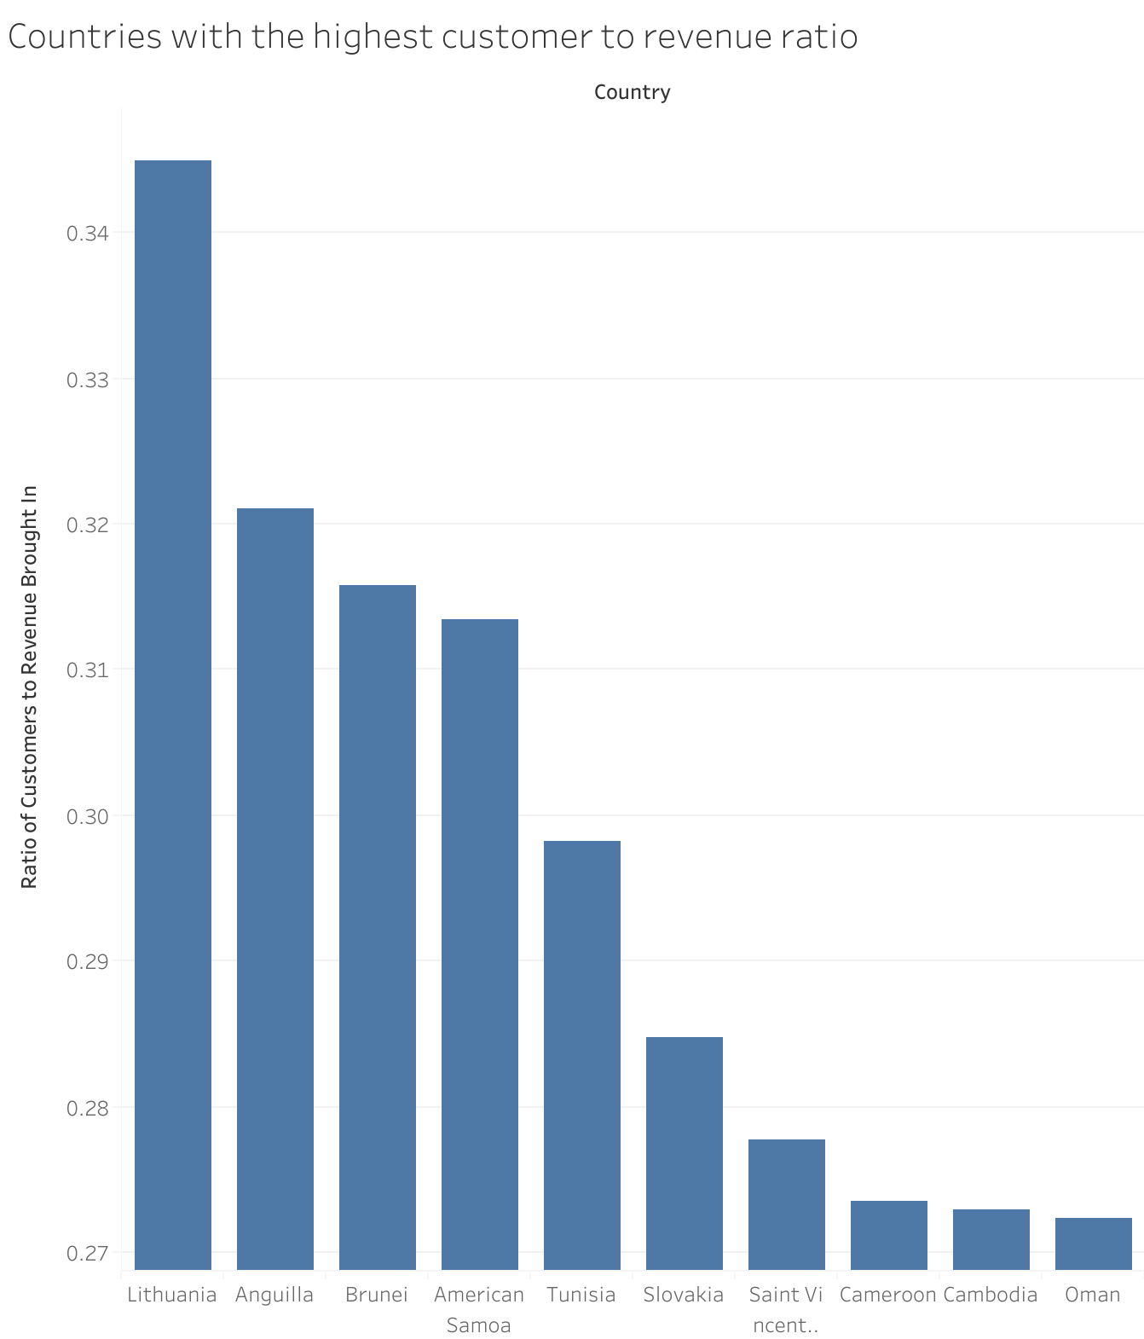
These top ten countries have the loyalist customers. With the least amount of customers bringing in the most amount of revenue:
1. Lithuania
2. Anguilla
3. Brunei
4. American Samoa
5. Tunisia
6. Slovakia
7. Saint Vincent
8. Cameroon
9. Cambodia
10. Oman

Slide 8
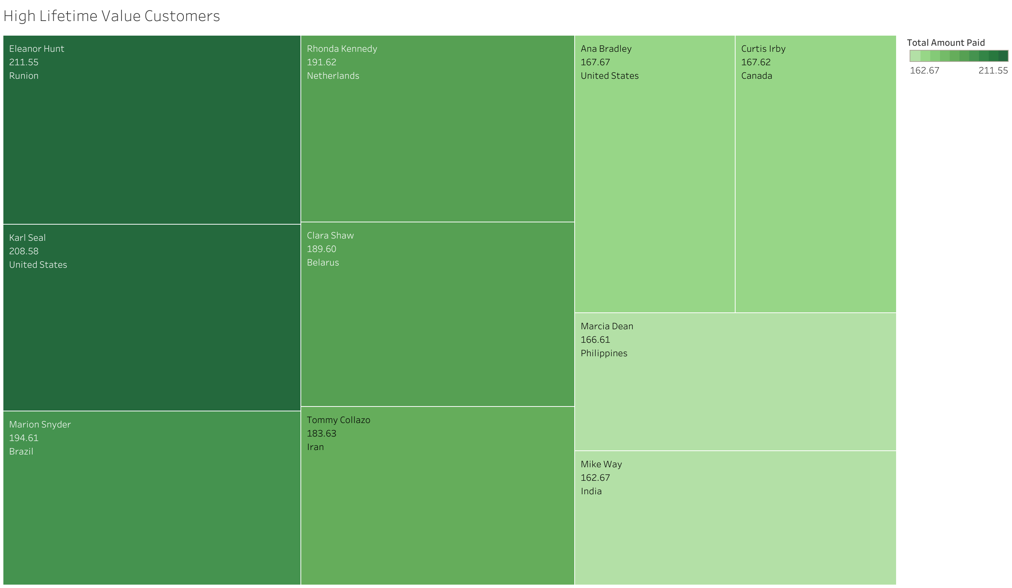
Customers With High Lifetime Value
Giving these customers, who are located globally, an incentive to keep purchasing from Rockbuster could help achieve more loyal customers like these top 10.

Slide 9
Recommendations
Launching an Online Movie Streaming Service
Based on the current revenue generated from India, China, United States, Japan, & Mexico, I would suggest launching the streaming service in those top five countries.
Subscription
With many streaming platforms out like Netflix, Hulu, and Disney+ there will be high competition among subscription users. Rockbuster will need to separate itself among its competitors. I recommend a lower monthly cost and this could be achieved by allowing advertisements from other companies. Giving an incentive for one free movie download every 6 months as a customer.
Customer Reward Program
With some customers paying up to $211 for movies, I would suggest rewarding those consumers with an incentive. Perhaps every ten movies rented, you receive one free movie rental or if we migrate to subscription based then one month free. We could look into the countries with low customer to revenue ratio and focus on marketing the reward program to them.

